Slide 1

Model to Predict Churn in Syriatel
Yasitha De Alwis

Slide 2

Objective
Develop a statistical model to predict Customer Churn

Slide 3
Modelling Approach
No of Records : 3333
Training Data 2499
Testing Data 834
No of Variables : 21
Numerical Data : 17
Categorical Data : 4
Model used : Logistic Regression
Predictor Variable : churn with True or False response
Notes:
For this purpose we have used a data set of 3000+ customers and 25% of used as the testing data to validate the model. It contained 17 numerical variable and 4 categorical variables. For modelling we have used an iterative approach using logistic regression and

Slide 4
Model Effectiveness
Model | Train Score | Test Score | Train logloss | TesT Logloss | CV | Precision | Recall | Accuracy | F1 Score
Dummy Model | 0.8667 | 0.8501 | 0.4989 | 0.5008 | 0.0000 | 0.00 | 0.00 | 0.85 | 0.00
Logistic Regression without SMOTE | 0.8735 | 0.8573 | 0.3112 | 0.3270 | 0.3131 | 0.57 | 0.20 | 0.86 | 0.30
Logistic Regression with SMOTE | 0.7771 | 0.7746 | 0.4989 | 0.5008 | 0.4611 | 0.38 | 0.77 | 0.77 | 0.51
Log with Poly Feature | 0.8575 | 0.8489 | 0.3489 | 0.3668 | 0.5553 | 0.50 | 0.80 | 0.85 | 0.61
gs model* | 0.9084 | 0.8909 | 0.2395 | 0.3214 | 0.5921 | 0.61 | 0.74 | 0.89 | 0.67
*gs model - Logistic with Poly Feature with hyperparameter adjustments
Notes:
Started with the dummy model and measuring the effectiveness looked at logistic model, logistic model with poly feature and gs model. Essentially another logistic with poly feature model with hyperparameter adjusted. At each stage model performance was evaluated on train data and test data. So higher the score better the model performance is. If you observe the except for recall all other indicators are highest in the gs model. Where logistic model with hyper parameter adjusted.
Accuracy:
Interpretation: The proportion of correctly classified instances out of the total instances.
Higher is better: A higher accuracy score indicates better performance.
Precision:
Interpretation: The proportion of true positives (correctly predicted positive instances) out of all predicted positives.
Higher is better: A higher precision score indicates fewer false positives.
Recall (Sensitivity):
Interpretation: The proportion of true positives out of all actual positives.
Higher is better: A higher recall score indicates fewer false negatives.
F1 Score:
Interpretation: The balance between precision and recall. It's the harmonic mean of precision and recall.
Higher is better: A higher F1 score indicates a good balance between precision and recall.

Slide 5
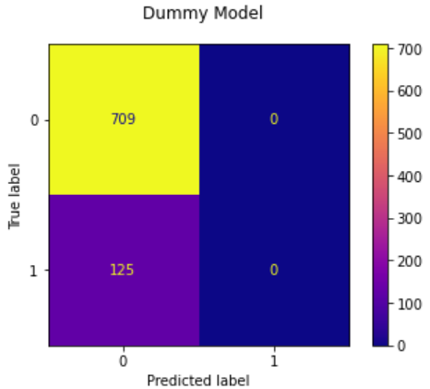
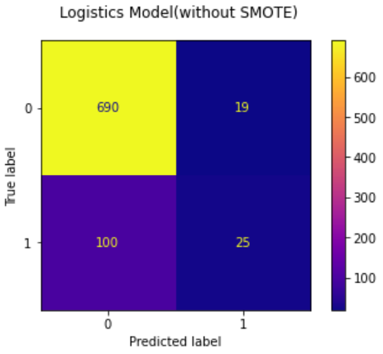
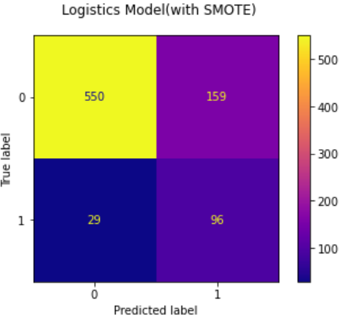
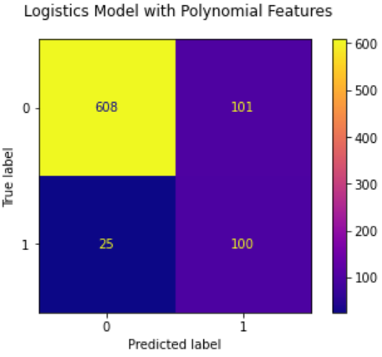
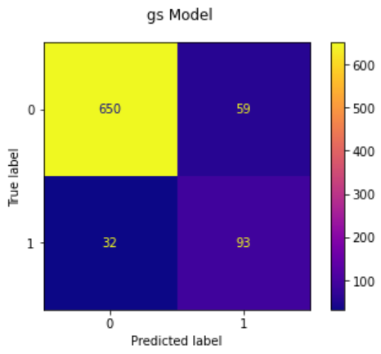

Model Effectiveness : Confusion Matrix
85%
86%
77%
125
119
188
F-Score 0
F-Score 0.52
85%
89%
126
91
F-Score 0.62
F-Score 0.67
Notes:
Looked at how test data categories into the qudrants. Out main focus is to reduce the incorrect categorization. Whether person is not going to churn predict as churn and person going to churn categories as not going to churn as that could impact business adversely. If you look at the counts of incorrect classification has come down to 94 in gs model

Slide 6
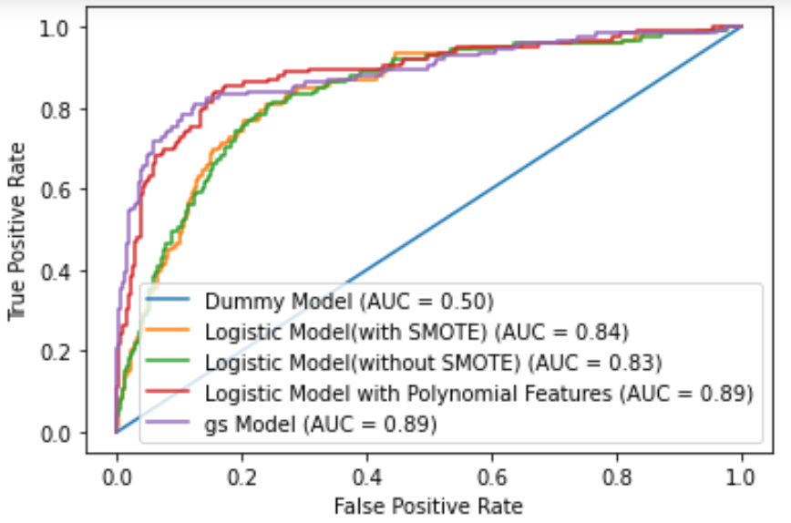
ROC curve
Model Effectiveness : Area Under the Receiver Operating Characteristic Curve
Notes:
Then applied another measurement to identify model effectiveness. So inspected Area under the ROC curve. So better the model the curve should point towards top left corner. So again better model is gs model.

Slide 7

Recommendation
Logistic Regression Model with Polynomial Feature
Imputer strategy : mean
Degree of Polynomial :3
C = 1
Solver = liblinear
Tolerance : 0.0001
No of iterations = 100

Slide 8
Model Usage
phone number | Predicted Churn
382-4657 | 0
371-7191 | 0
358-1921 | 1
375-9999 | 0
330-6626 | 0
Develop Strategies for
Customer Retention
Personalize Engagement
Customer Satisfaction

Slide 9

Next steps
Validate the model using expanded data set
Use other classification models
Implement the model in user friendly environment

Slide 10

Thank You

